Slide 1
Kentucky dashboard
File created on: 4/5/2025 1:47:28 PM

Slide 2
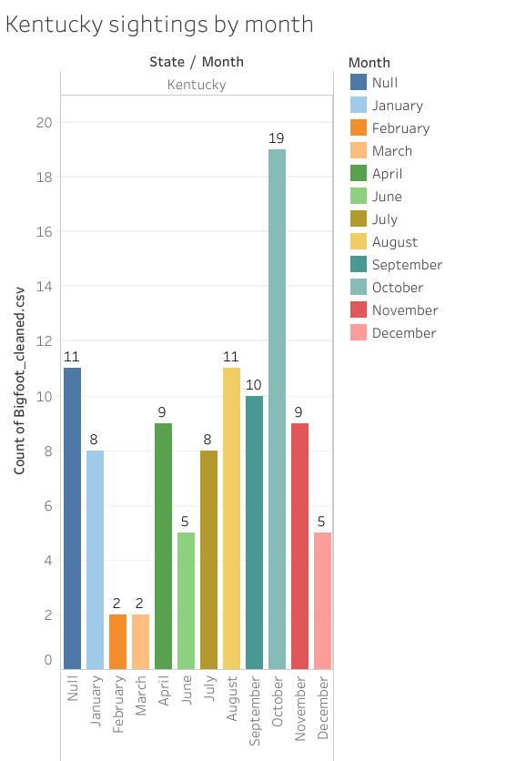

Slide 3
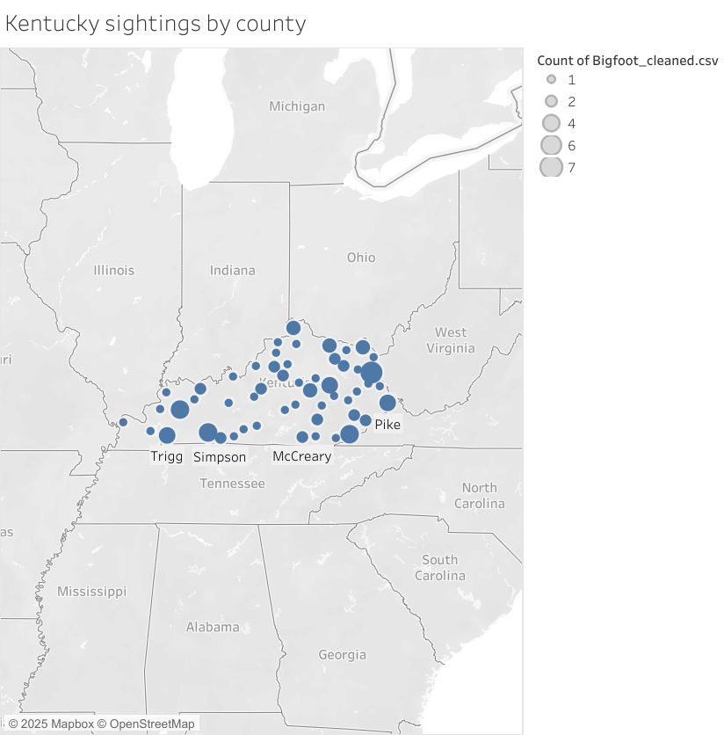

Slide 4
